Slide 1
CHAPTER 4: OUTPUT

Slide 2
Output
data that has been processed into a useful form called information.
a computer processes input into output
Computers generate several types of output, depending on the hardware and software being used and the requirements of the user.

Slide 3
Four common types of output
Text - consists of characters that are used to create words, sentences, and paragraphs.
Graphics - are digital representations of non-text information such as drawings, charts, and photographs.
Audio - is music, speech, or any other sound.
Video - consists of images that are played back at speeds that provide the appearance of full motion.

Slide 4
OUTPUT DEVICE

Slide 5
OUTPUT DEVICES
any computer component capable of conveying information to a user
Commonly used output devices include display devices, printers, speakers, headsets, data projectors, facsimile machines, and multifunction devices.

Slide 6
DISPLAY DEVICE

Slide 7
DISPLAY DEVICES
an output device that visually conveys text, graphics, and video information.
Information shown on a display device often is called softcopy, because the information exists electronically and is displayed for a temporary period of time.

Slide 8
Types of Display Device

Slide 9
CRT (Cathode Ray Tube)
a display device that consists of a screen housed in a plastic or metal case.
a large glass tube called a cathode ray tube (CRT). The screen, which is the front of the tube, is coated with tiny dots of phosphor material that glow when electrically charged.
Inside the CRT, an electron beam moves back and forth across the back of the screen, causing the dots to glow, which produces an image on the screen.
A color monitor displays text, graphics, and video information in color.
A monochrome monitor displays text, graphics, and video information in one color (usually white, amber, or green) on a black background.

Slide 10
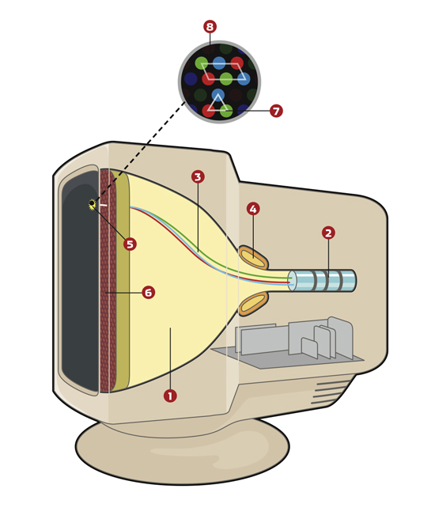
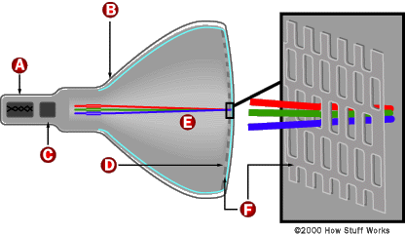

Slide 11
Pixel (short for picture element)
a single point in an electronic image.
Monitors consist of hundreds, thousands, or millions of pixels arranged in rows and columns that can be used to create images.
The pixels are so close together that they appear connected.

Slide 12


Slide 13
Flat-Panel Displays
a lightweight, thin screen that consumes less power than a CR1 monitor. Two common types of flat-panel displays are LCD and gas plasma.

Slide 14
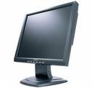
LCD (Liquid Crystal Display)
A liquid crystal display (LCD) has special molecules (called liquid crystals) deposited between two sheets of material.
When an electric current passes through them, the LCD displays commonly are used in laptop computers, handheld computers, digital watches,’ and calculators because they are thinner and more lightweight than CRT monitors.

Slide 15
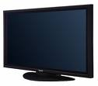
Gas Plasma Monitors
which can measure more than 42 inches and hang directly on a wall Gas plasma monitors use gas plasma technology, which substitutes a layer of gas for the liquid crystal material in an LCD monitor.
When voltage is applied, the gas glows and produces the pixels that form an image.

Slide 16
Monitor Quality

Slide 17
Monitor Quality
The resolution, or sharpness and clarity, of a monitor is related directly to the number of pixels it can display.
Resolution is expressed as two separate numbers: the number of columns of pixels and the number of rows of pixels a monitor can display.
A monitor with a higher resolution displays a greater number of pixels, which provides a smoother image.
A higher resolution, however, also causes images to display smaller.

Slide 18
dot pitch
which is a measure of image clarity. The dot pitch is the vertical distance between each pixel on a monitor.
The smaller the distance between the pixels, the sharper the displayed image.

Slide 19
refresh rate
The speed that the monitor redraws images on the screen
a monitor’s refresh rate should be fast enough to maintain a constant, flicker-free image.
A slower refresh rate causes the image to fade and then flicker as it is redrawn, which can cause headaches for users.
measured according to hertz, which is the number of times per second the screen is redrawn.
older monitors refresh images using a technique called interlacing.

Slide 20
refresh rate
Interlace - the electron beam draws only half the horizontal lines with each pass (for example, all odd-numbered lines on one pass and all even-numbered lines on the next pass)
Noninterlaced - they provide a much better, flicker-free image than interlaced monitors.

Slide 21
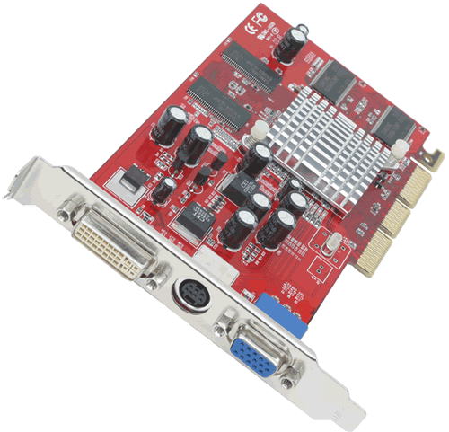
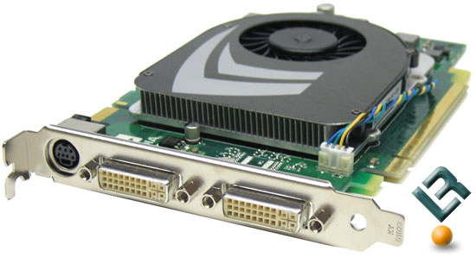
Video Cards
a graphics card or video adapter, converts digital output into an analog video signal that is sent through a cable to the monitor.
The monitor separates the video signal into red, green, and blue signals.
Electron guns then fire the three color signals to the front of the monitor.
These three dots - one red, one green, and one blue are combined to make up each single pixel.

Slide 22
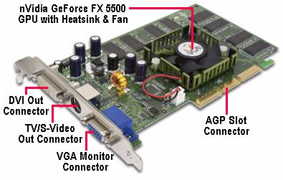

Slide 23
Video Cards
an 8-bit video card (also called 8-bit color) uses 8 bits to store information about each pixel and thus can display 256 different colors, a 24-bit video card uses 24 bits to store information about each pixel and can display 16.7 million colors.
higher-quality video cards use video RAM or VRAM (pronounced VEEram) to improve the quality of graphics.

Slide 24
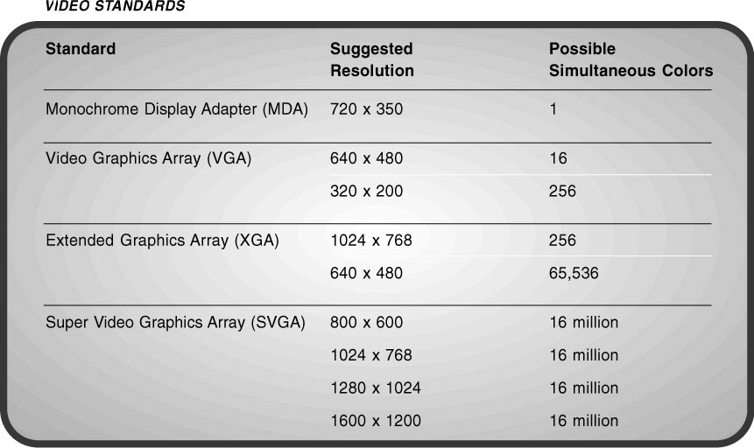
if you wanted an 800 x 600 resolution with 16-bit color (65,536 colors), then your video card should have at least 1 MB of VRAM.

Slide 25
PRINTER

Slide 26
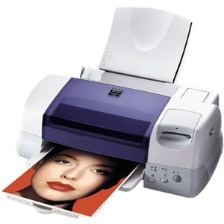
PRINTER
an output device that produces text and graphics on a physical medium such as paper or transparency film.
Printed information is called hardcopy or printout because the information exists physically and is a more permanent form of output
Impact and Non-impact Printers

Slide 27
Impact Printers
forms characters and graphics on a piece of paper by striking a mechanism against an ink ribbon that physically contacts the paper.
Letter quality (LQ) output is a quality of print acceptable for business letters.
Near Letter Quality (NLQ) impact printers are used for jobs that require only near letter quality, such as printing mailing labels, envelopes, or invoices.

Slide 28
Types of Impact Printers
DOT-MATRIX PRINTERS
an impact printer that produces printed images when tiny wire pins on a print head mechanism strike an inked ribbon.
use continuous-form paper, in which each sheet of paper is connected together.
pages have holes punched along two opposite sides so the paper can be fed through the printer.
contain nine to twenty-four pins, depending on the manufacturer and the printer model.
measured by the number of characters per second (cps)

Slide 29
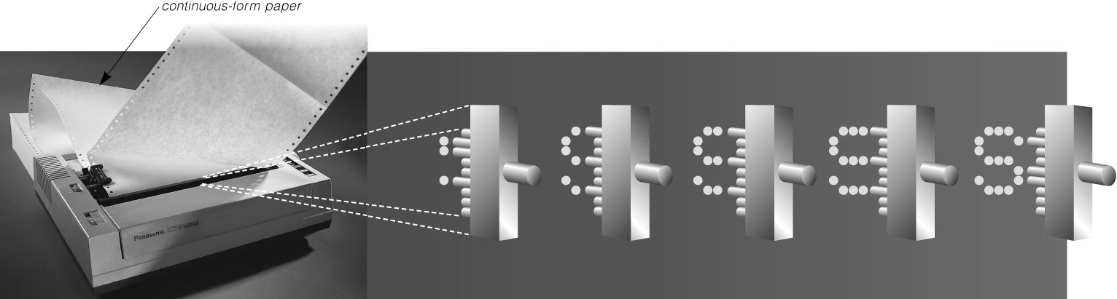
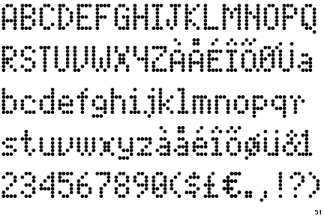

Slide 30
Types of Impact Printers
LINE PRINTER
a high-speed impact printer that prints an entire line at a time.
The speed of a line printer is measured by the number of lines per minute (lpm) it can print.
Capable of printing up to 3,000 lines per minute (1pm), these printers often are used with mainframes, minicomputers, or with a network in applications such as manufacturing, distribution, or shipping.
11 x 17-inch continuous-form paper.

Slide 31
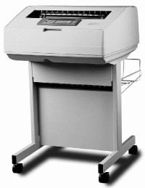
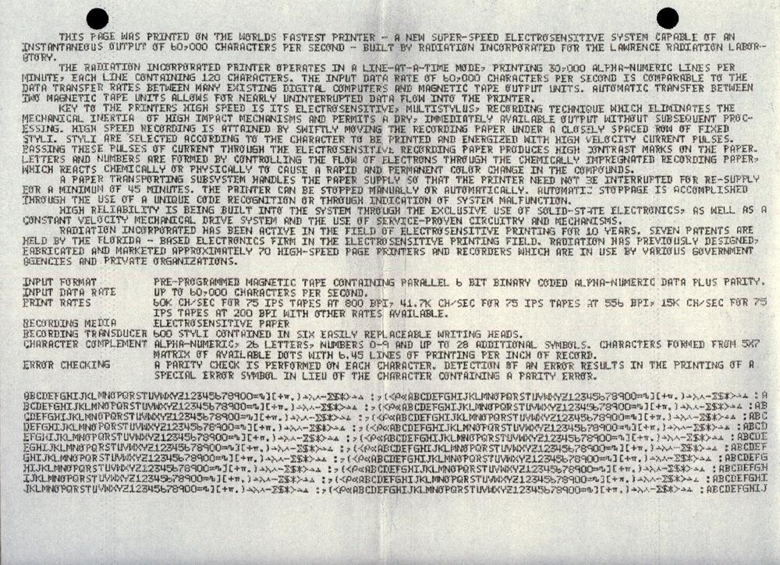

Slide 32
Nonimpact Printers
forms characters and graphics on a piece of paper without actually striking the paper.
Some spray ink, while others use heat and pressure to create images.
Because these printers do not strike the paper, they are much quieter than the previously discussed impact printers.

Slide 33
Types of Non-Impact Printers
INKJET PRINTERS
Forms characters and graphics by spraying tiny drops of liquid ink onto a piece of paper.
resolution is measured by the number of dots per inch (dpi) a printer can output.
speed is measured by the number of pages per minute (ppm) it can print.
ink can be propelled by heat or pressure through any combination of the nozzles to form a character or image on the paper.

Slide 34
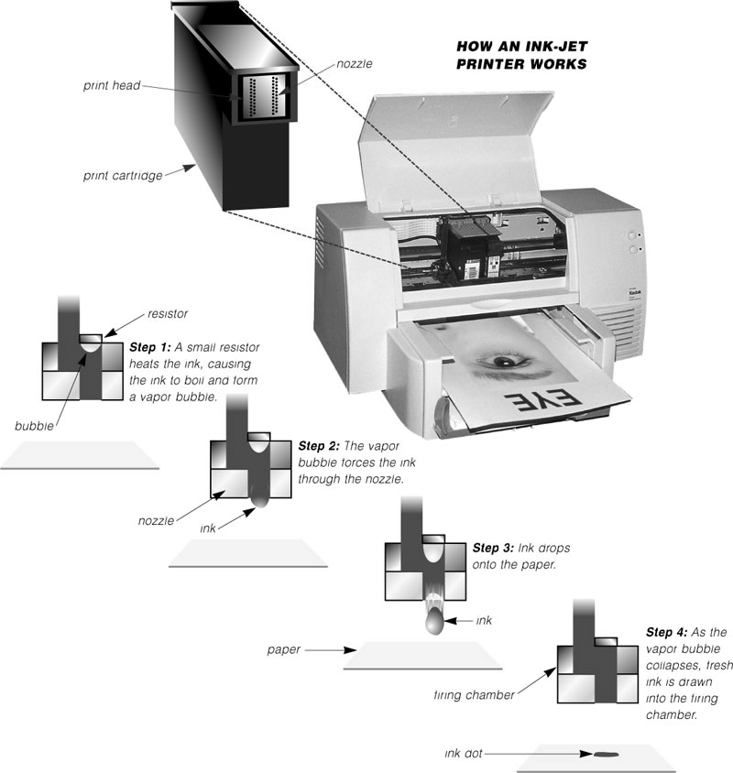

Slide 35
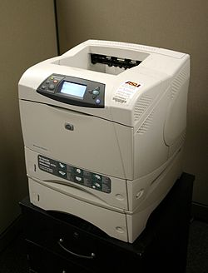
Types of Non-Impact Printers
LASER PRINTERS
creates images using a laser beam and powdered ink, called toner which is packaged in a cartridge.
The light of the laser alters the electrical charge on the drum wherever it hits.
a laser printer can have up to 200 MB of memory
Page Description Language (PDL)
PCL (Printer Control Language)

Slide 36
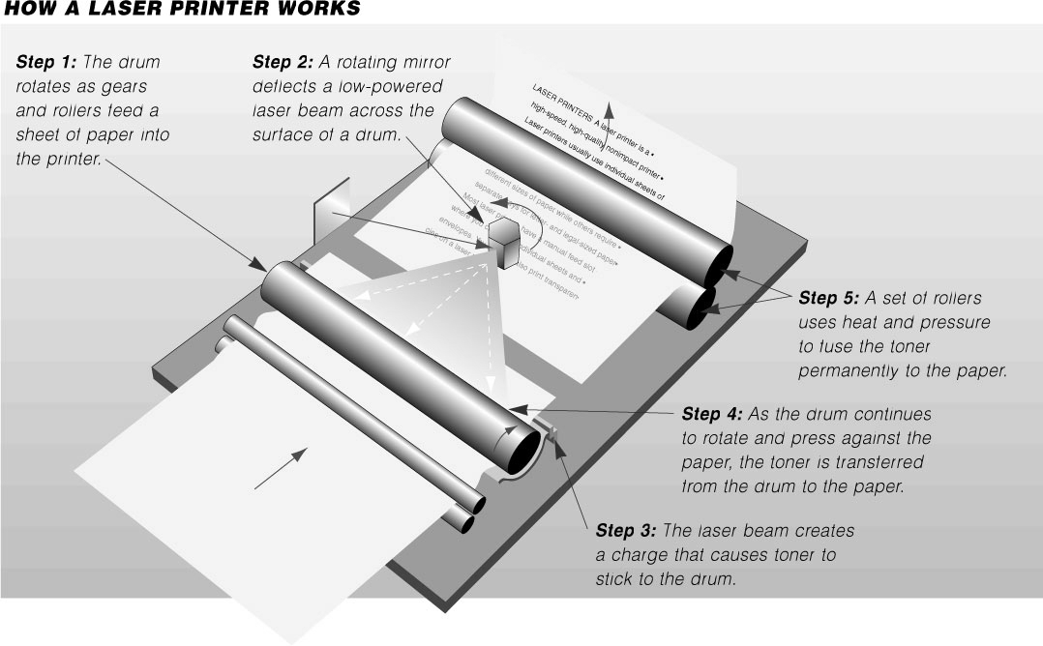

Slide 37
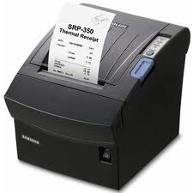
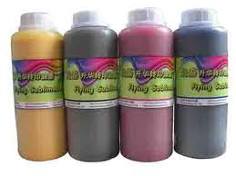
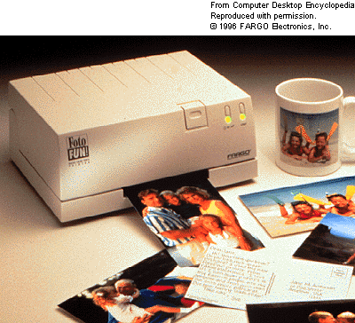
Types of Non-Impact Printers
THERMAL PRINTERS
generates images by pushing electrically heated pins against heat-sensitive paper.
thermal wax-transfer printer
generates rich, non-smearing images by using heat to melt color-wax onto heat-sensitive paper.
dye-sublimation printer
thermal dye transfer printer, uses heat to transfer colored dye to specially coated paper.

Slide 38
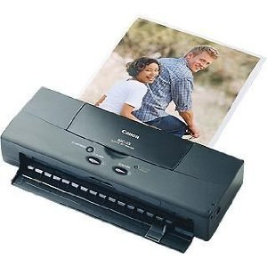
Types of Non-Impact Printers
Portable Printers
A portable printer is a small, lightweight printer that allows a mobile user to print from a laptop or handheld computer while travelling.

Slide 39
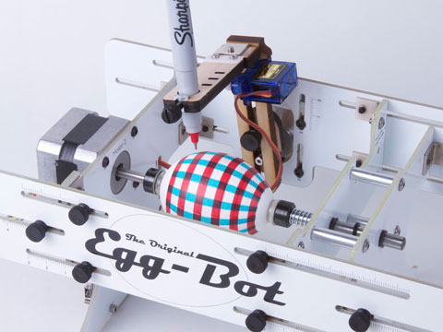
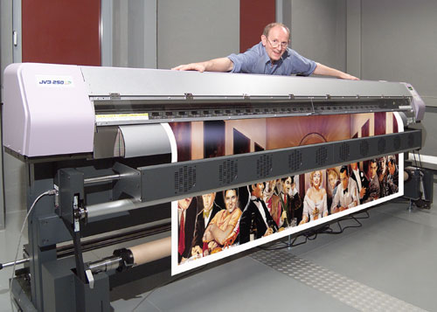
Types of Non-Impact Printers
Plotters and Large-Format Printers
sophisticated printers used to produce high-quality drawings such as blueprints, maps, circuit diagrams, and signs.
pen plotter - uses one or more color pen light beams, or a scribing device to draw on paper or transparencies.
electrostatic plotter - uses a row of charged wires (called styli) to draw an electrostatic pattern on specially coated paper and then fuses toner to the pattern.

Slide 40
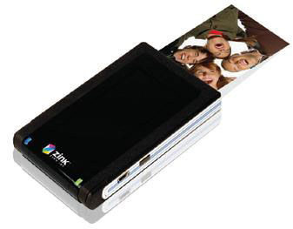
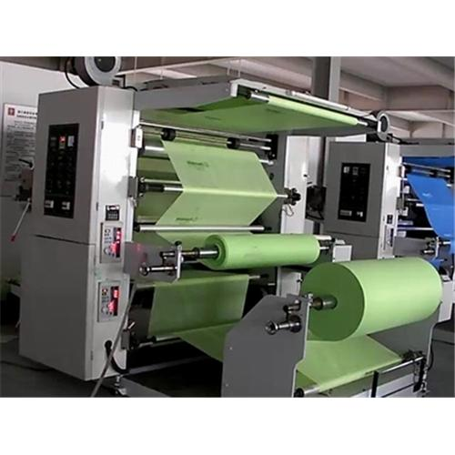
Types of Non-Impact Printers
Special-Purpose Printers
photo printer is a color printer designed to produce photo lab quality pictures directly from a digital camera.
A label printer is a small printer that prints on an adhesive-type material that can be placed on a variety of items such as envelopes, disks, audiocassettes, photographs, and toys.

Slide 41
AUDIO OUTPUT

Slide 42
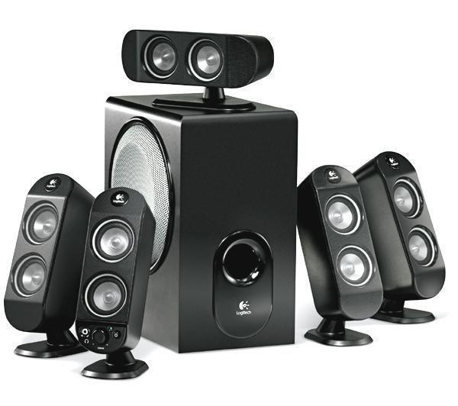
AUDIO OUTPUT
Audio is music, speech, or any other sound. Audio output devices are the components of a computer that produce music, speech, or other sounds, such as beeps.
Two commonly used audio output devices are speakers and headsets.
To boost the low bass sounds, you can add a woofer (also called a subwoofer).

Slide 43
OTHER OUTPUT DEVICES

Slide 44
Data Projectors
takes the image that displays on a computer screen and projects it onto a screen so that an audience of people can see the image clearly.
It can be large devices attached to a ceiling or wall in an auditorium, or they can be small portable devices. Two types of smaller, lower-cost units are LCD projectors and DLP projectors.

Slide 45
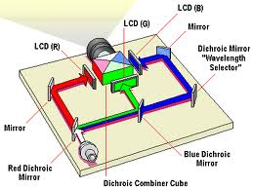
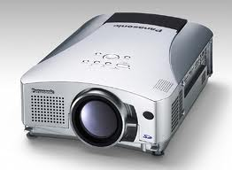
LCD projector
which uses liquid crystal display technology, attaches directly to a computer and uses its own light source to display the information shown on the computer screen.

Slide 46
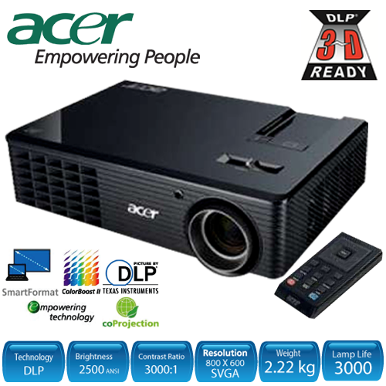
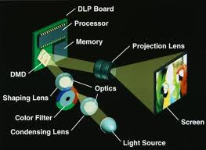
DLP Projector
uses tiny mirrors to reflect light, producing crisp, bright, colorful images that remain in focus and can be seen clearly even in a well-lit room.

Slide 47
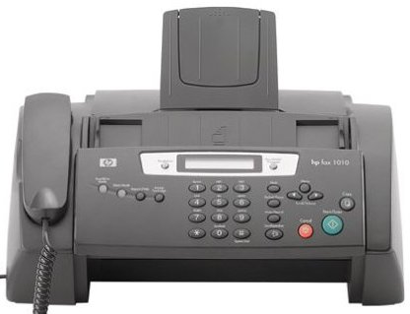
Facsimile (Fax) Machine
a device that transmits and receives documents over telephone lines.
When sent or received via a fax machine, these documents are known as faxes.
A fax modem is a communications device that allows you
to send (and sometimes receive) electronic documents as faxes.

Slide 48
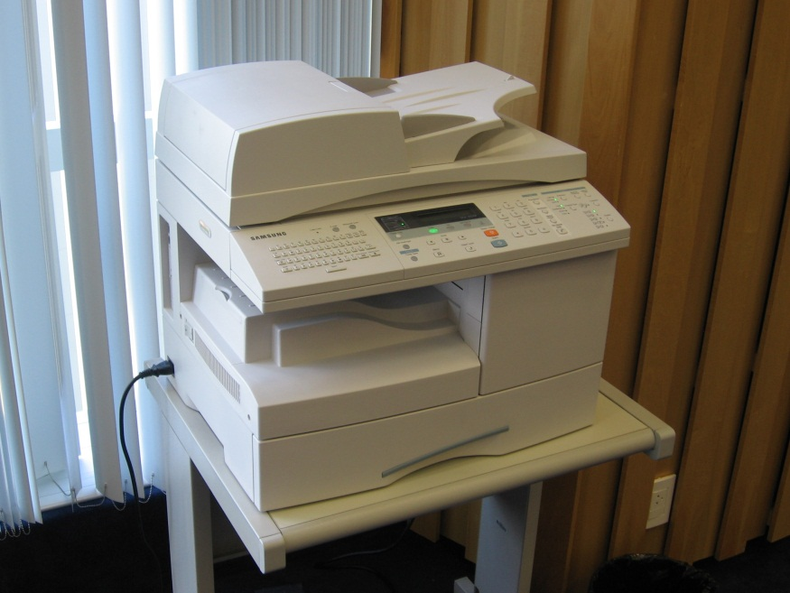
Multifunction Devices
a single piece of equipment that looks like a copy machine but provides the functionality of a printer scanner, copy machine, and perhaps a fax machine.
multifunction peripheral

Slide 49
TERMINALS

Slide 50
Terminal
A terminal is a device that performs both input and output because it consists of a monitor (output), a keyboard (input), and a video card.
Terminals fall into three basic categories: dumb terminals, intelligent terminals, and special-purpose terminals.

Slide 51
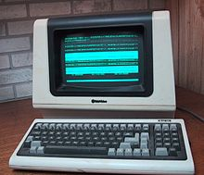
dumb terminal
has no processing power, and thus, cannot function as an independent device.
used to enter and transmit data to, or receive and display information from, a computer to which it is connected.
Dumb terminals are connected to a host computer that performs the processing and then sends the output back to the dumb terminal.

Slide 52
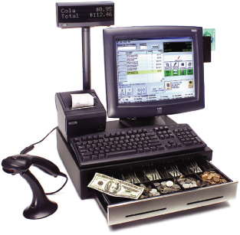
Special-purpose terminal
perform specific tasks and contain features uniquely designed for use in a particular industry.
point-of-sale terminals and automatic teller machines.

Slide 53
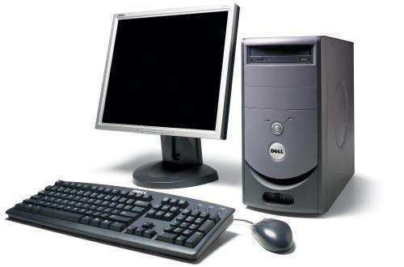
intelligent terminal
has memory and a processor that has the capability of performing some functions independent of the host computer.
Intelligent terminals sometimes are called programmable terminals because they can be programmed by the software developer to perform basic tasks.

Slide 54
OUTPUT DEviCES FOR PHYSICALLY CHALLENGED USERS

Slide 55
The growing presence of computers in everyone’s lives has generated an awareness of the need to address computing requirements for those with physical limitations.
For users with mobility, hearing, or vision disabilities, many different types of output devices are available. Hearing-impaired users, for example, can instruct programs to display words instead of sounds.
With Windows, such users also can set options in the Accessibility Properties dialog box to instruct Windows
to display visual signals in situations where normally it would make a sound

Slide 56
Visually impaired users can change Windows settings such as increasing the size or changing the color of the text to make the words easier to read.
Instead of using a monitor, blind users can utilize speech output, where the computer reads the information that displays on the screen. Another alternative is a Braille printer, which outputs information in Braille onto paper.

